Slide 1
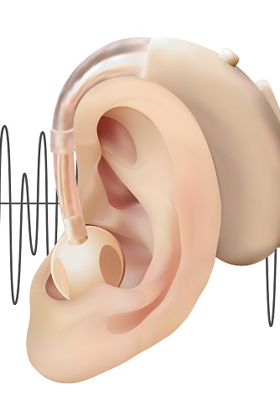
DIGITAL HEARING AID USING MATLAB
COMMUNICATION SYSTEM MTE PROJECT
Presented by:
Md Zeeshan Eqbal
(2K20/EC/123)
Presented to:
Prof. Sachin Taran

Slide 2
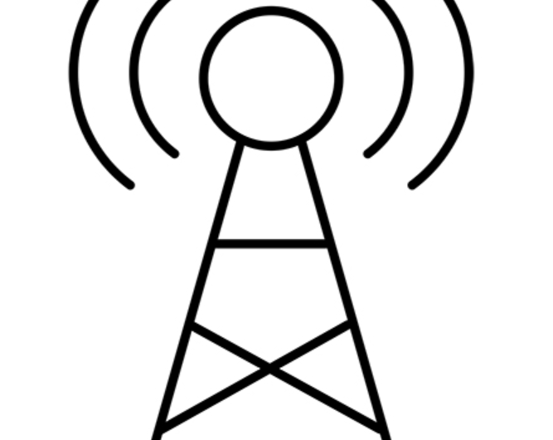
INDEX
INTRODUCTION- Digital Hearing Aid
FLOW CHART
METHODOLOGY
CODE & OUTPUT FUTURE SCOPE
CONCLUSION
REFERENCE

Slide 3
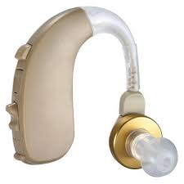
INTRODUCTION
One of the most important issues for human being is aid in hearing. They are actually small electronic instruments which make sound louder and make speech easier to hear and understand. It has been designed to pick up sound waves with a microphone, change weaker sounds into louder sounds and send them to the ear through a speaker. With the microchips available today, hearing aids have become smaller and smaller and have significantly improved in quality.
A hearing aid is an electronic device that makes sounds louder and can help to offset hearing loss. The aim of the hearing aid is to amplify sound signals in such a way that they become audible for the hearing impaired person.

Slide 4
WHAT IS DIGITAL HEARING AID
Hearing loss is not just a technical loss of volume rather, hearing deficiency can increase sensitivity and reduce tolerance to certain sounds while diminishing sensitivity to others.
A digital hearing aid has a computer inside to control it. The computer memory stores settings for its user. The computer program uses the stored settings to tailor the hearing aid sound to suit the user.
Through the use of digital signal processing, digital hearing aid now offers what the analog hearing aid can't offer. The stimulation of simple digital hearing aid will be developed using MATLAB programming language.

Slide 5
PROBLEM STATEMENT
Discuss to develop digital hearing aid using MATLAB code
OBJECTIVE
The goal of hearing aid amplification is to improve a person's access to sound.
Depending on the degree and configuration of individual's hearing loss, the hearing aid is tasked with increasing sound levels at different frequency regions to ensure that incoming speech frequency are reching the ear.
Through the use of digital signal processing, to understand the MATLAB code.

Slide 6
FLOW CHART
INPUT SPEECH SIGNAL
NOISE ADDITION
NOISE REDUCTION FILTER
FREQUENCY SHAPER
AMPLITUDE DECOMPRESSION
OUTPUT

Slide 7
METHODOLOGY
Noise Addition:
If the input speech signal for this system is a clean signal, some noise must be added to model a real situation. So the Additive White Gaussian Noise (AWGN) and random noise are added to the input speech signal by using MATLAB function.
Noise Reduction:
To eliminate the noise, a reduction filter function is used in this design. To suppress the noise in the signal, the wavelet filter function is used.
Frequency Filter:
The frequency shaper is designed to correct for the loss of hearing at certain frequencies. It applies high gain for higher frequencies and vice versa
Amplitude Compression:
Amplitude compression function is the task of controlling the overall gain of a speech amplification system. Amplitude compression will ensure that the amplified signal will not exceed saturation power.

Slide 8

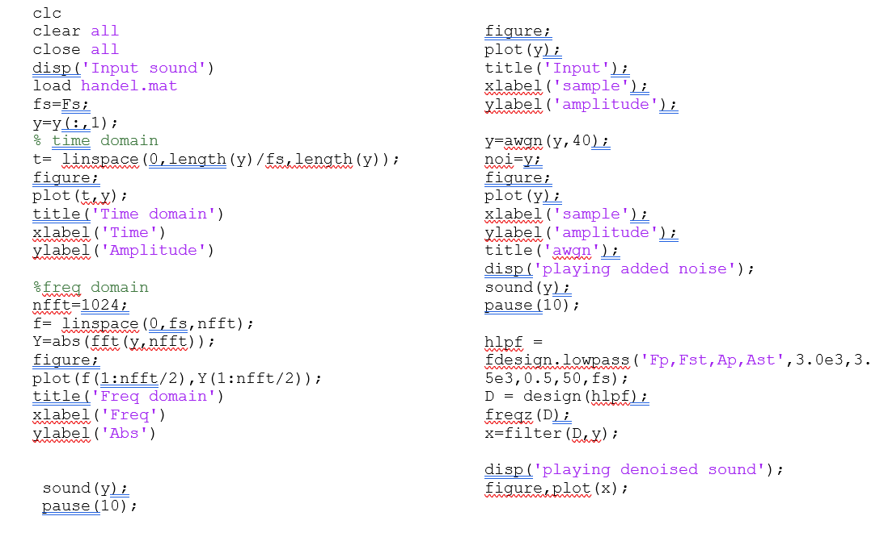
MATLAB CODES

Slide 9
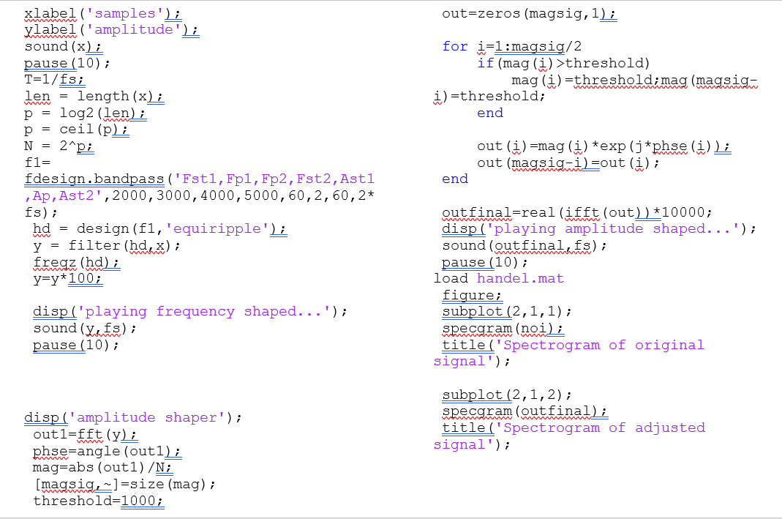
MATLAB CODES

Slide 10
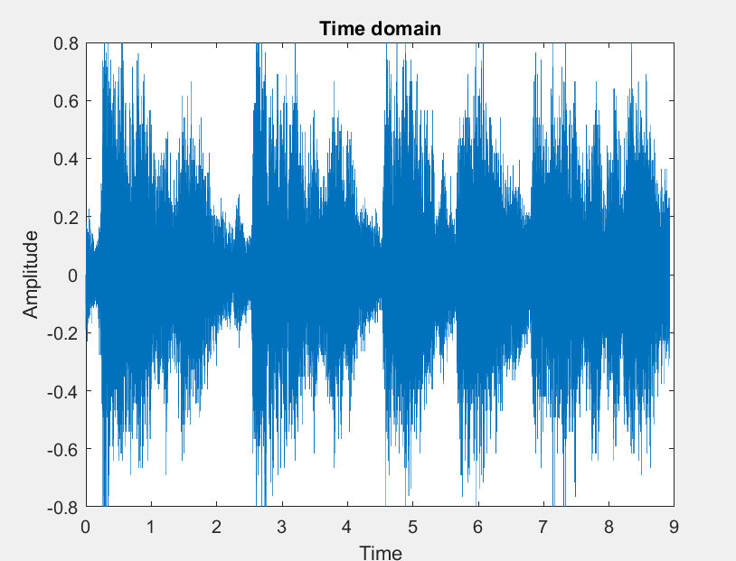
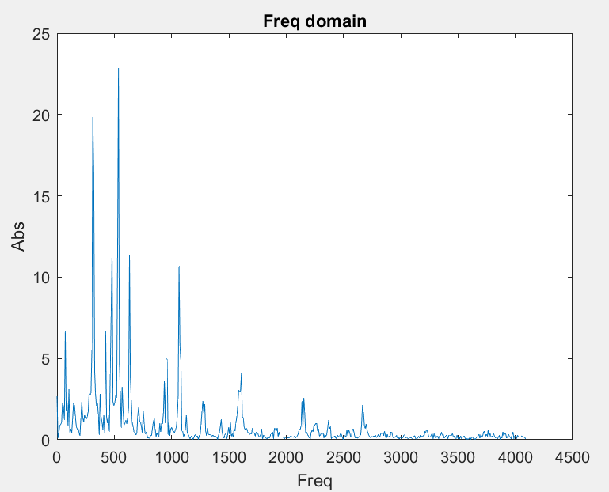
MATLAB OUTPUT

Slide 11
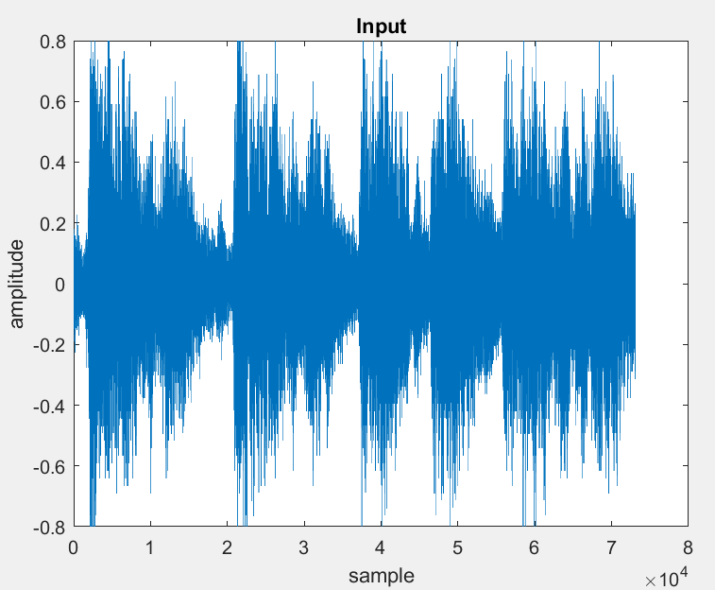
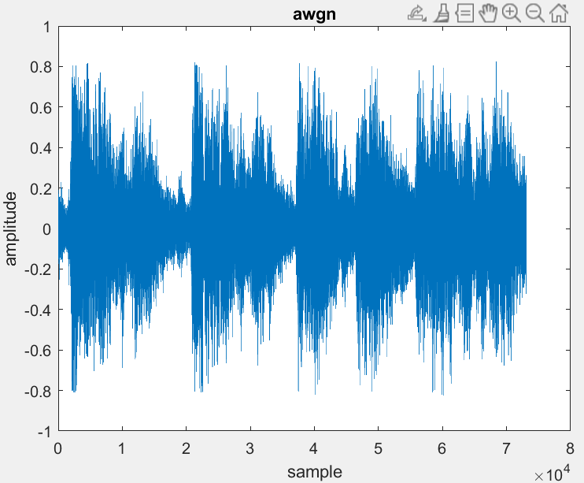
MATLAB OUTPUT

Slide 12
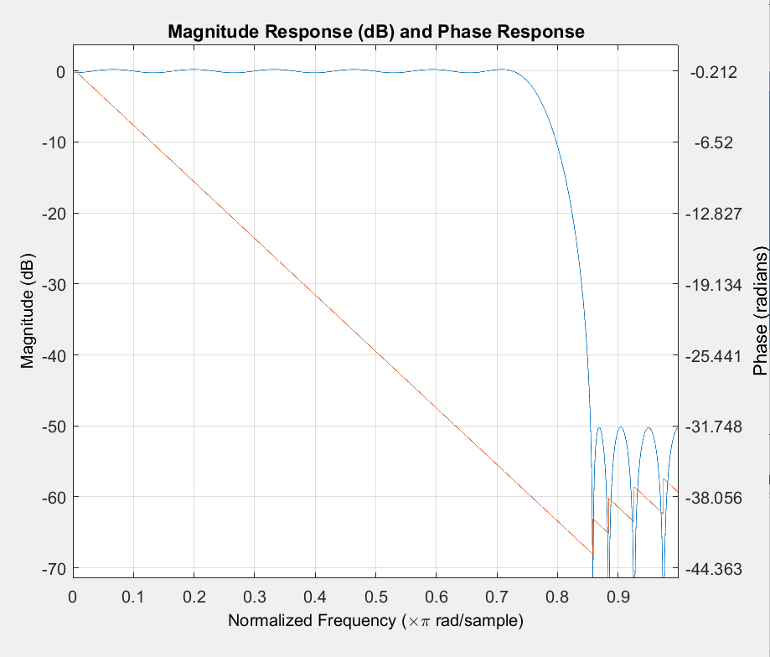
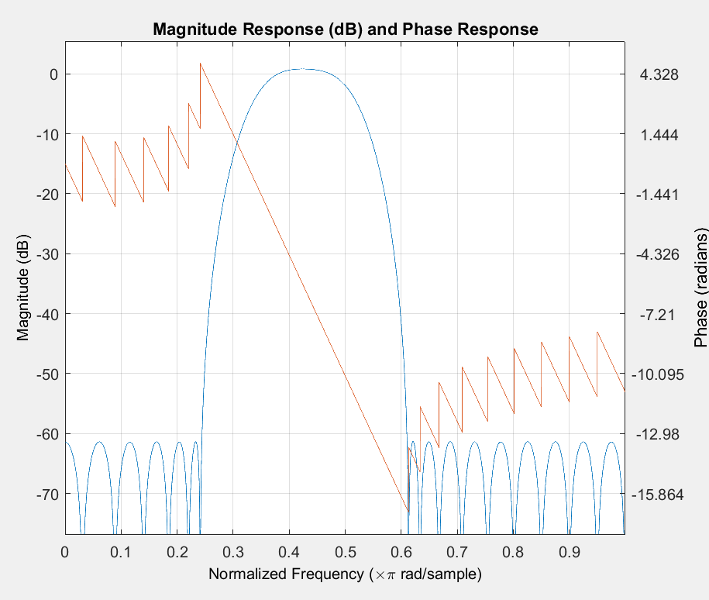
MATLAB OUTPUT

Slide 13
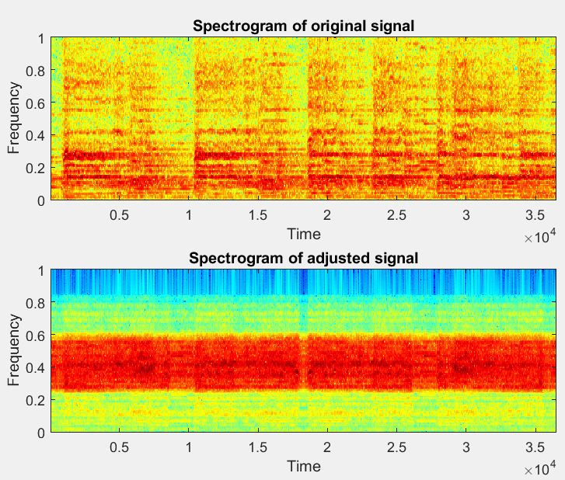
MATLAB OUTPUT

Slide 14
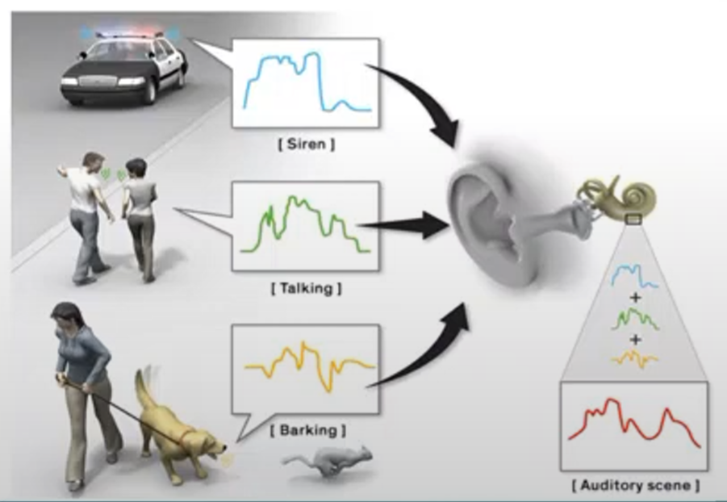
FUTURE SCOPE
Can be improved, such that it can intelligently detect the required inputs according to user's need.
To improve the quality of signal being processed.
To able to remove types of noise and make it easier for the person, who has lost his hearing abilities.

Slide 15
CONCLUSION
The newer digital aid is more capable of fine-tuning the sound without distorting the quality. In this digital hearing aids system implementation using MATLAB, sound processing is digitalized. Thus, it is possible to refine the sound signal, for instance by reducing noise and improving speech signals.
In addition, by using digital technology, the amplification can be done only at the frequencies that the user needs to amplify. This will eliminate the problems with conventional amplifier which amplified the whole signal including the noise. In general, digital hearing aid converts the incoming signals to digital signals.
This digitalization makes its possible to precisely analyze & filter the signals. The signals can be processed in one or more frequency channels. At the end, the digital signal is again converted to its analog form. The benefits of using digital aids can improve quality of life by improving sound quality.

Slide 16

THANK YOU

